Slide 1
Pointer
Rakib Mahmud

Slide 2
Pre-requisite
int x=5;
When a program is run; a memory address is allocated for x variable.
In that address, 5 value is stored.
Variable name -> x
Value -> 10
Variable address -> 100
printf(“Value of x = %d\n”, x);
printf(“Address of x = %d\n”, &x);

Slide 3
Introduction
Pointer is a variable that stores the address of another variable.
We can store the address of x in a pointer.
So pointer works with memory address.

Slide 4
Why Pointer
Using pointer makes the software more efficient cause it works with memory management.
But excessave usage may make the application less understandable.

Slide 5
How to Use Pointers?
The use of pointers in C can be divided into three steps:
Pointer Declaration
Pointer Initialization
Pointer Dereferencing

Slide 6
Declaration of Pointer
data_type *var_name;
Example:
int *p, char *p
The pointer declared here will point to some random memory address as it is not initialized.
Such pointers are called wild pointers.

Slide 7
Pointer Initialization
We generally use the ( ‘&’: ampersand ) addressof operator to get the memory address of a variable and then store it in the pointer variable.
Pointer must be the same data type as the variable it points to.
int x = 10; int * ptr; ptr = &x;
printf(“Value of x = %d\n”, x);
printf(“Address of x = %d\n”, &x);
printf(“Address is = %d\n”, ptr);

Slide 8
Pointer Dereferencing
Dereferencing a pointer is the process of accessing the value stored in the memory address specified in the pointer.
We use the same ( * ) dereferencing operator that we used in the pointer declaration.
ptr
Address of pointer variable ptr
0x7fffa0757dd4
0x7fff98b499e8
Value of variable var (*ptr)
x
10
Address of variable ‘x’
Stored at ptr
0x7fffa0757dd4

Slide 9
Pointer Dereferencing (Cont’d)
int x = 10; int * ptr; ptr = &x;
printf(“Value of x = %d\n”, x);
printf(“Address of x = %d\n”, &x);
printf(“Address is = %d\n”, ptr);
printf(“In that address value is = %d\n”, *ptr);
printf(“Address of ptr variable is : %d\n”,&ptr);

Slide 10
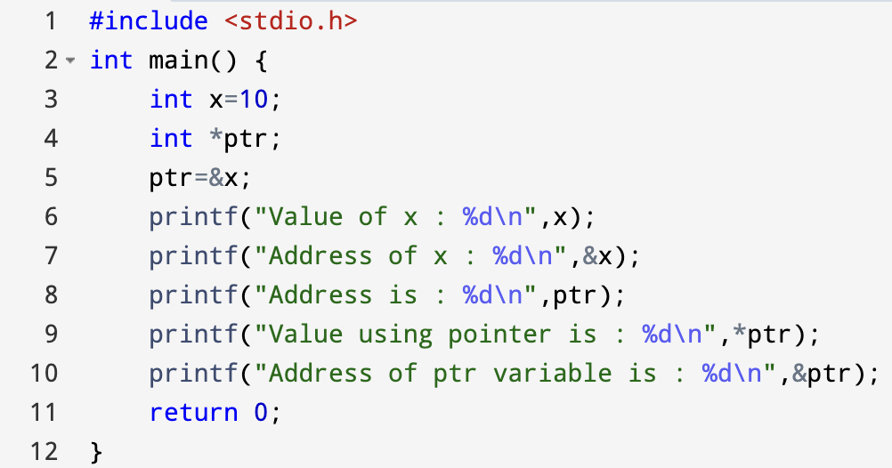
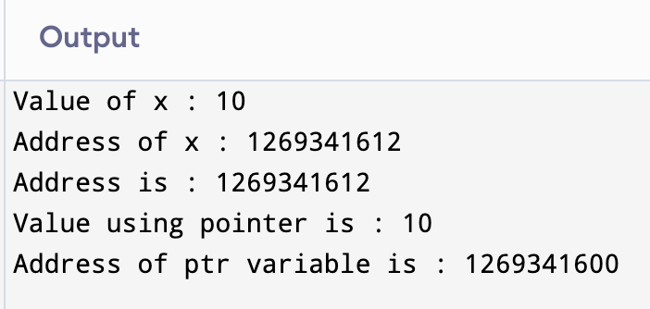
C Program to Do All Those Three Steps at once

Slide 11
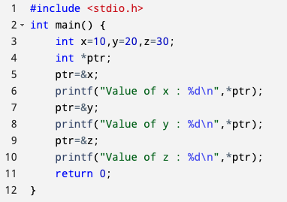
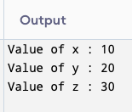
C Program for Printing Different Variable Values That The Pointer Points to

Slide 12
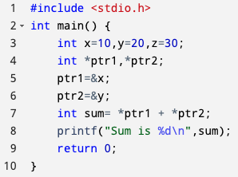
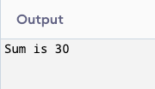
C Program for Adding Two Numbers Using Pointer

Slide 13
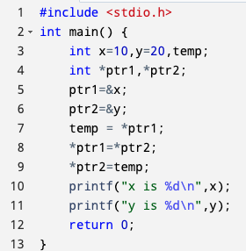
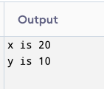
C Program for Swapping Two Numbers Using Pointer

Slide 14
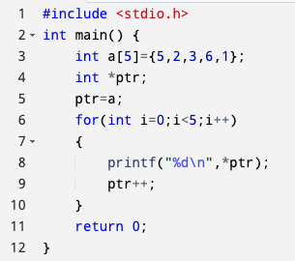

C Program for Accessing Array Elements Using Pointer

Slide 15
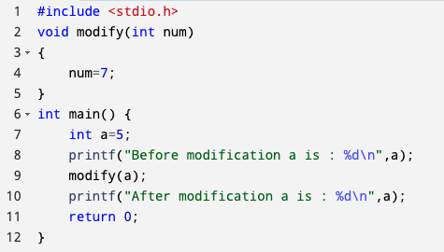
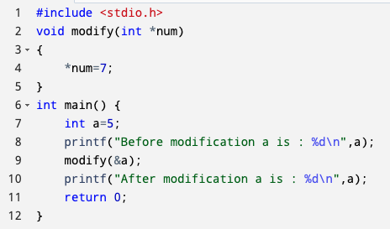
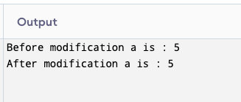
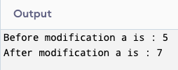
Call by Value vs Call by Reference

Slide 16
Call by Value vs Call by Reference (Cont’d)
Call by value | Call by reference
While calling a function, we pass the values of variables to it. Such functions are known as “Call By Values”. | While calling a function, instead of passing the values of variables, we pass the address of variables(location of variables) to the function known as “Call By References.
In this method, the value of each variable in the calling function is copied into corresponding dummy variables of the called function. | In this method, the address of actual variables in the calling function is copied into the dummy variables of the called function.
With this method, the changes made to the dummy variables in the called function have no effect on the values of actual variables in the calling function. | With this method, using addresses we would have access to the actual variables and hence we would be able to manipulate them.
Call by value is considered safer as original data is preserved | Call by reference is risky as it allows direct modification in original data

Slide 17
Thank You

